Slide 1

Comparison of two algorithms with Viola Jones: MTCNN and YOLO
Kalybek Aruzhan

Slide 2
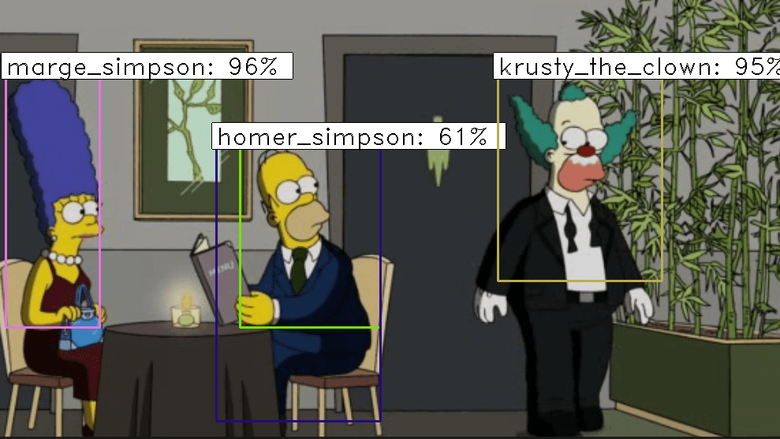
Algorithms
YOLO (You Only Look Once) is a family of models for real-time object detection. YOLO processes an image in a single pass through the neural network, dividing it into a grid and predicting object coordinates, classes, and confidence scores. Its main advantage is high speed, making it popular for video analytics, autonomous systems, and computer vision applications.
MTCNN (Multi-task Cascaded Convolutional Neural Network) is a cascaded convolutional neural network for face detection and landmark localization (eyes, nose, and mouth corners). It consists of three stages (P-Net, R-Net, O-Net) that progressively refine the detected face regions. MTCNN is widely used in biometrics, emotion analysis, and image processing.

Slide 3

Key Features of YOLO
Single-Pass Detection – Unlike region-based approaches (e.g., R-CNN), YOLO processes the entire image at once, predicting bounding boxes and class probabilities in a single forward pass.
Speed and Efficiency – YOLO is one of the fastest object detection models, capable of running in real-time on GPUs and even some edge devices.
Global Context Awareness – By processing the full image, YOLO captures global context, reducing false positives and improving detection accuracy.
Versatility – YOLO can detect multiple objects of different classes in a single image, making it suitable for autonomous driving, video surveillance, robotics, and more.
Scalability – The YOLO family includes different model versions and sizes (e.g., YOLOv8n, YOLOv8s, YOLOv8m, etc.) to balance speed and accuracy.

Slide 4
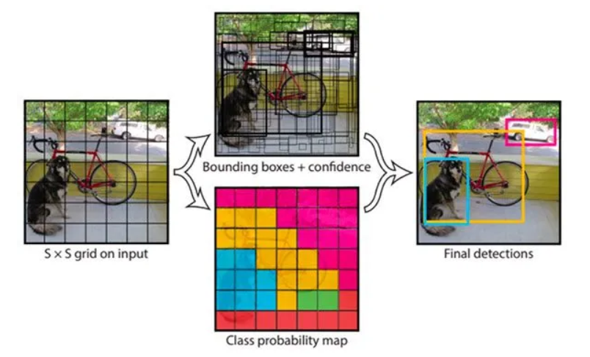
How YOLO Works
Step 1. Image Grid Division
The input image is divided into an S × S grid (e.g., 7×7 for early versions).
Each grid cell is responsible for detecting objects whose center falls within it.
Step 2. Bounding Box Prediction
Each grid cell predicts B bounding boxes, each defined by:
(x, y) – Center coordinates (relative to the grid cell).
(w, h) – Width and height (relative to the image size).
Confidence Score – Indicates the likelihood of an object being present.
Step 3. Class Prediction
Each grid cell predicts class probabilities for objects it detects.
Step 4. Non-Maximum Suppression (NMS)
Overlapping bounding boxes are filtered, keeping only the most confident detections.

Slide 5
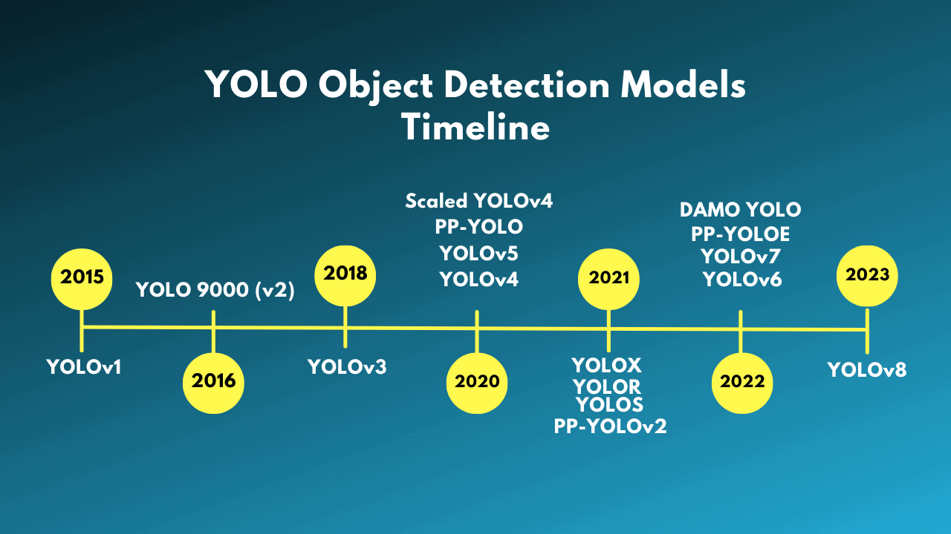
Evolution of YOLO
YOLOv1 (2015). First single-shot detector, fast but weak with small objects.
YOLOv2 (2016, YOLO9000). Added batch normalization, anchor boxes, and 9000-class detection.
YOLOv3 (2018). Multi-scale detection, Darknet-53 backbone, better small object detection.
YOLOv4 (2020). Enhanced training (Mish, CSPDarknet-53, Mosaic), improved accuracy and efficiency.
YOLOv5 (2021). Unofficial but widely used, better training speed and scalability.
YOLOv6 & YOLOv7 (2022). Optimized for speed-accuracy trade-offs.
YOLOv8 (2023). Developed by Ultralytics, uses CBAM attention, supports detection, segmentation, and pose estimation.

Slide 6
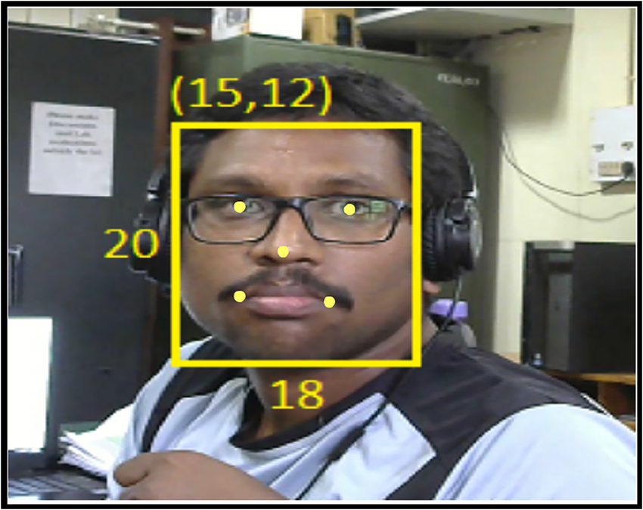
Key Features of MTCNN
Face Detection & Alignment – Detects faces and aligns them by identifying key facial landmarks (eyes, nose, mouth).
Cascaded Architecture – Uses a three-stage pipeline to refine detections progressively.
High Accuracy – Performs well under different lighting conditions, occlusions, and varying face angles.
Lightweight & Efficient – Can run on CPUs and GPUs, making it suitable for real-time applications.

Slide 7
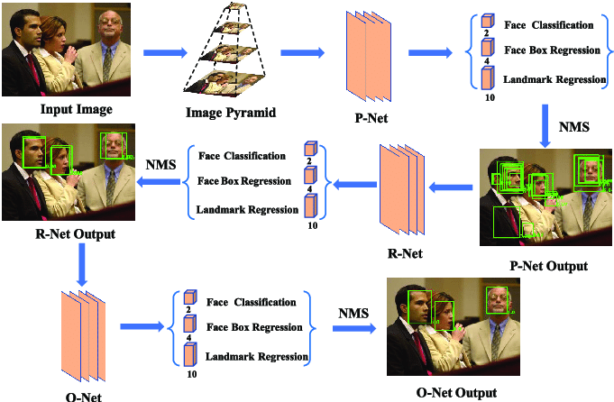
How MTCNN Works
MTCNN consists of three cascaded neural networks that progressively refine face detection results.
1. P-Net (Proposal Network) - takes the input image and generates candidate face regions. Uses a fully convolutional network to propose bounding boxes. Applies Non-Maximum Suppression (NMS) to remove duplicate boxes.
2. R-Net (Refine Network) - refines the bounding boxes proposed by P-Net. Further filters out false positives and adjusts bounding box positions.
3. O-Net (Output Network) - final stage that precisely detects facial landmarks (eyes, nose, mouth corners). Further refines bounding boxes and aligns faces correctly.

Slide 8
Comparison
Criterion | Viola-Jones | MTCNN | YOLO
Type | Classical algorithm (Haar cascades) | Deep learning (Cascaded CNN) | Deep learning (Single-shot CNN)
Purpose | Face detection | Face detection + facial landmark detection | General object detection
Accuracy | Low | High | Very high
Speed | Fast | Slower | Fast
Robustness to Lighting & Angles | Poor performance under variations | Good robustness | Good robustness
Output Data | Face bounding box | Bounding box + 5 facial keypoints | Bounding box + object class
Applications | Basic face detection (CCTV, simple face detectors) | Biometrics, face recognition, tracking | Autonomous systems, object recognition, video analytics

Slide 9
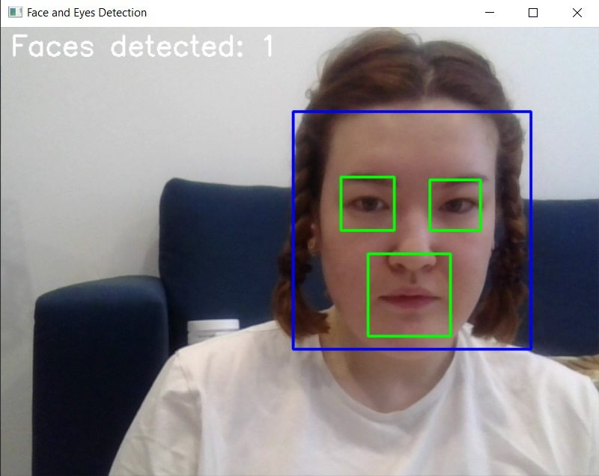
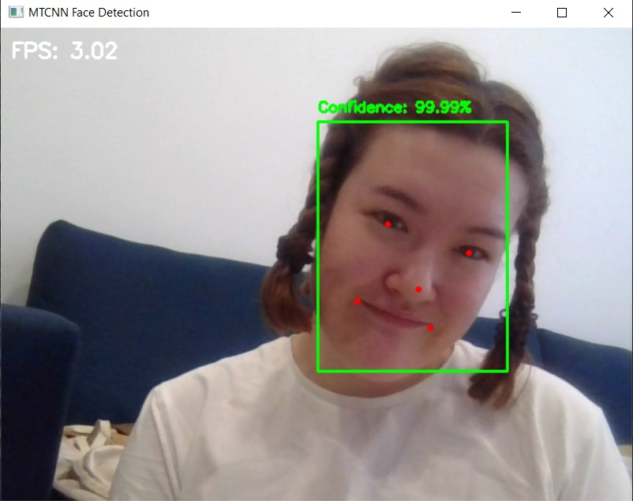
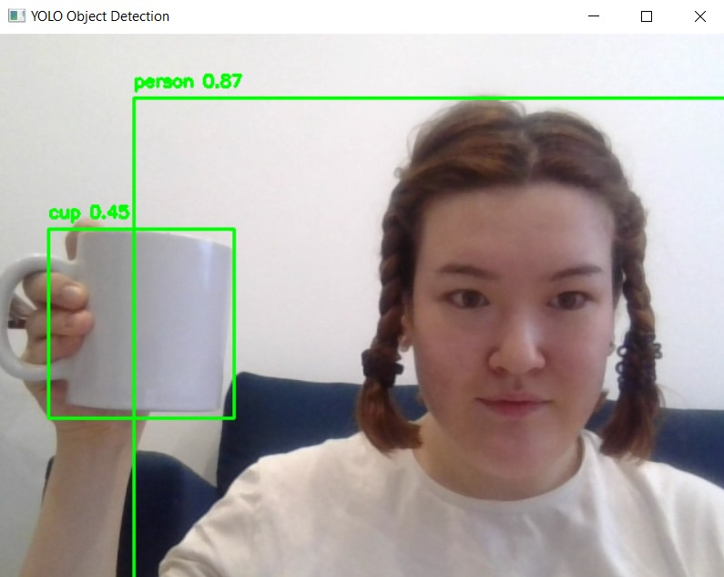
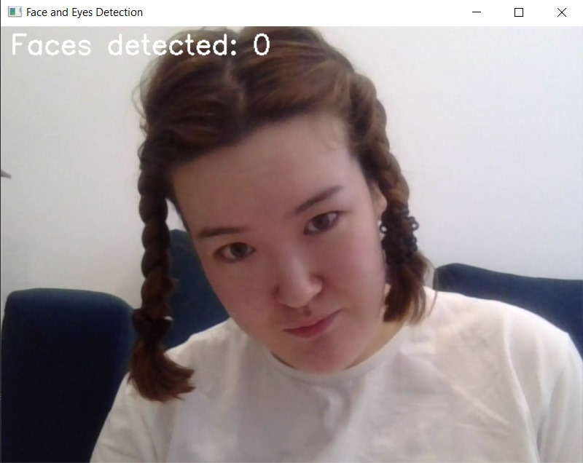
Example
MTCNN
YOLO
Viola-Jones

Slide 10
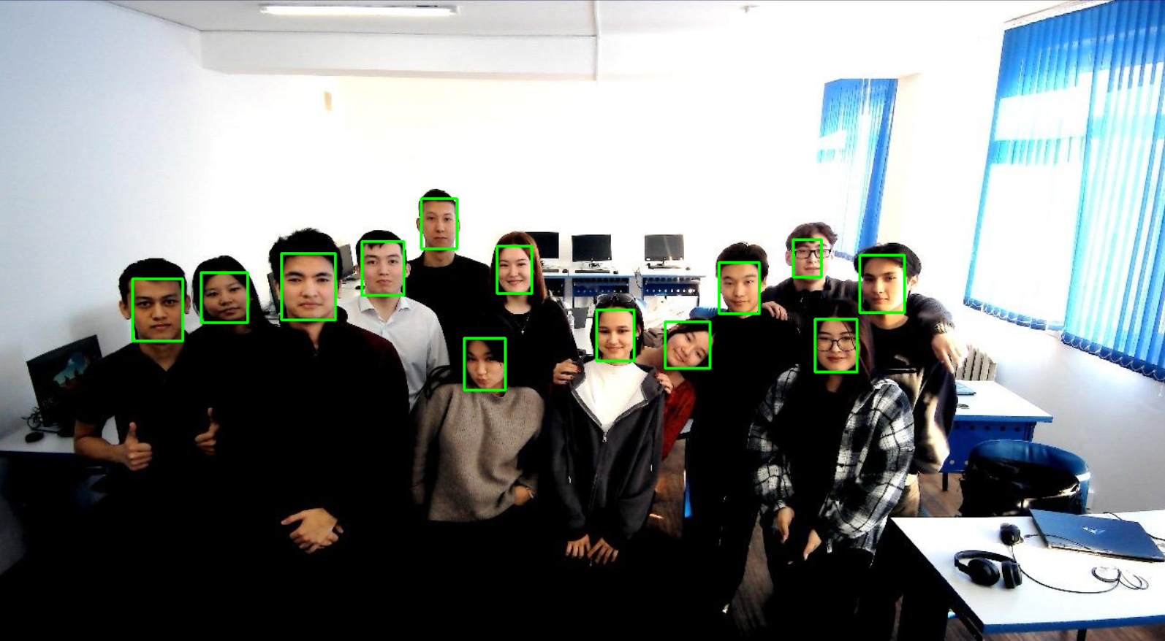
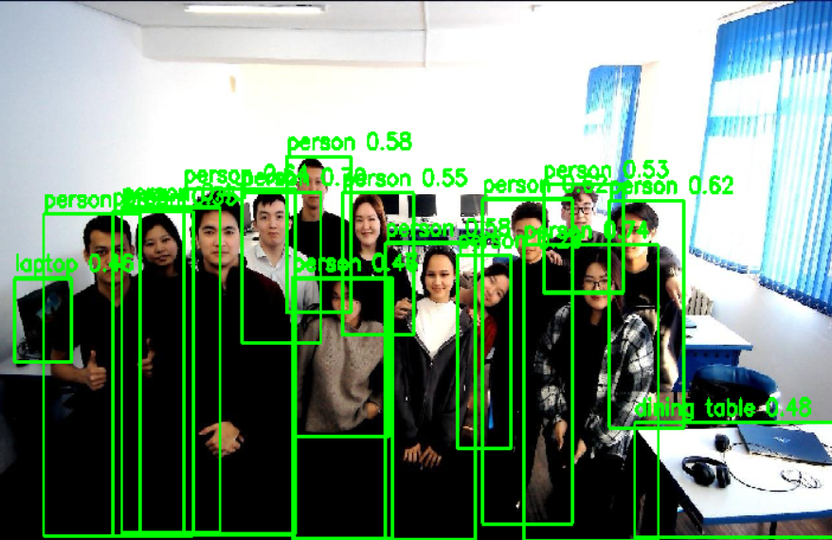
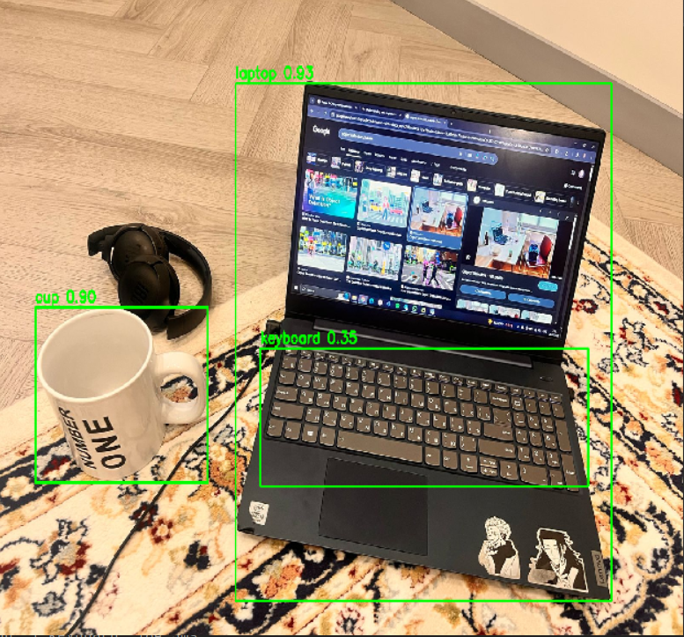
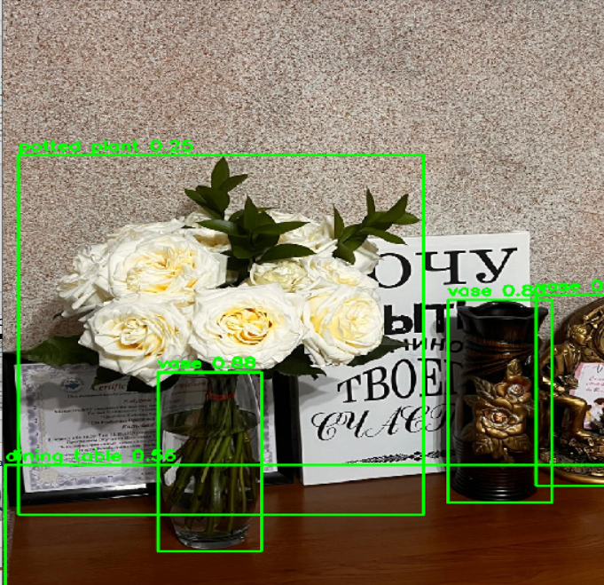
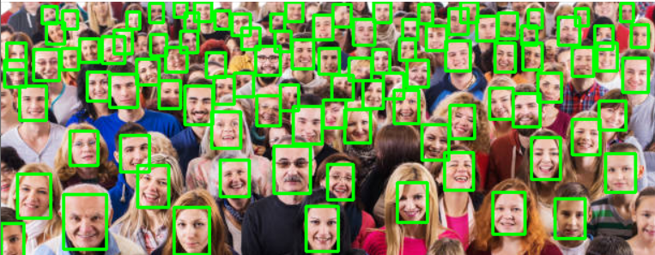
YOLO
MTCNN

Slide 11

Summary
Viola-Jones is a fast but inaccurate algorithm for simple face detection.
MTCNN is accurate but slow, and works well with faces and their key points.
YOLO is the most powerful, provides fast and versatile object detection, but requires more resources.
Viola-Jones
MTCNN
YOLO

Slide 12
Thanks for attention!

